Slide 1

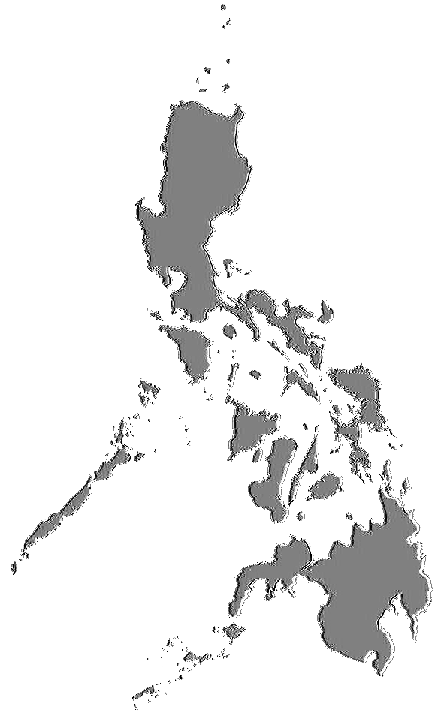
Transpinay rising (5:30)

Slide 2
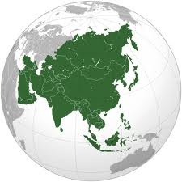
Being trans* in the Asia-Pacific: trans* rights, trans* health, trans* pride
Sam Winter,
Hong Kong

Slide 3
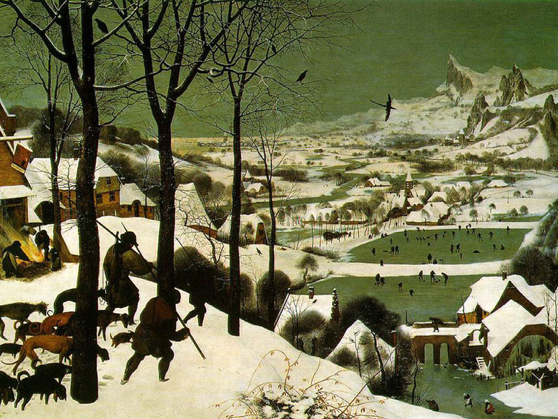
Pieter Breughel.
Hunters in the Snow (1565)

Slide 4
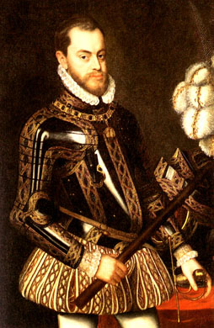
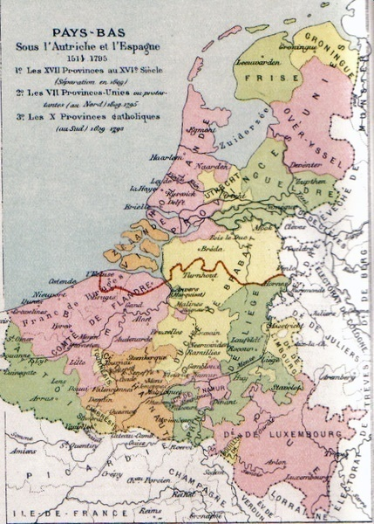
Philip II of Spain etc..
1527-1598
Lord of the Seventeen Provinces 1556-1581
The Dutch Revolt
1566- or 1568 - 1648

Slide 5
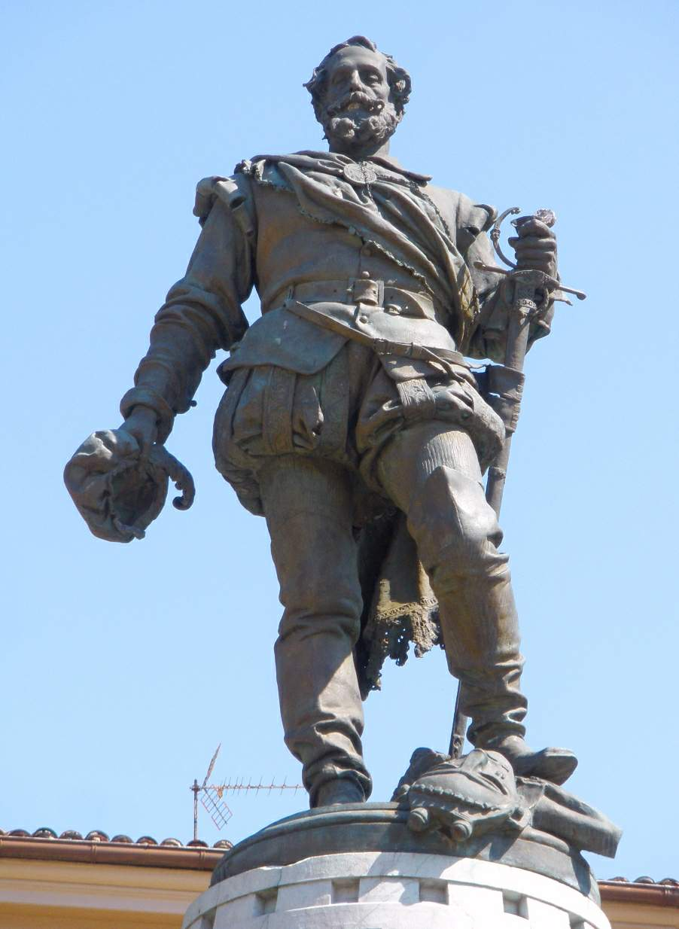
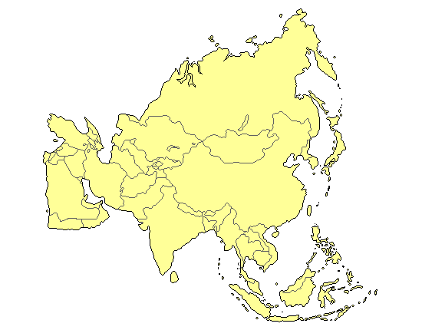
Miguel Lopez de Legazpi
1565

Slide 6
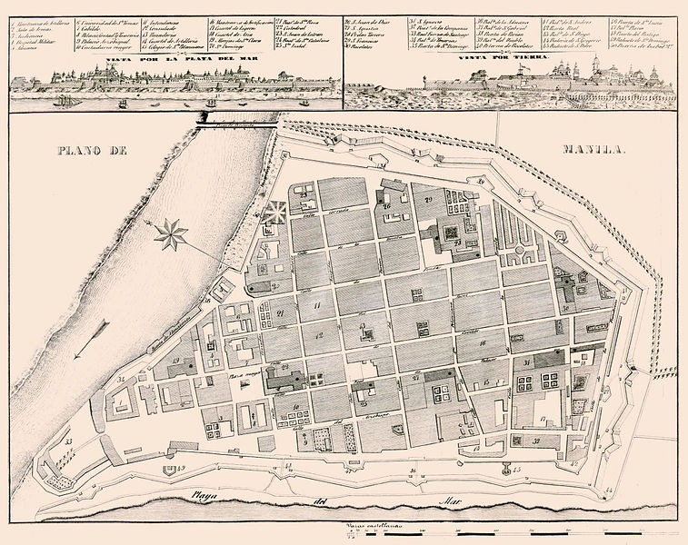
Intramuros, Manila

Slide 7
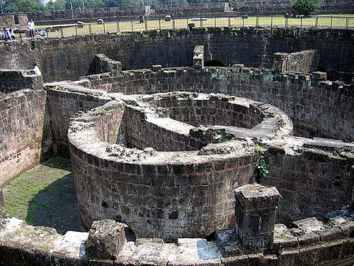
Intramuros, Manila

Slide 8
Sexuality and gender in the islands
Unfamiliar sexual and gender values:
Men and women “chieftains”
Virginity not valued
Adultery not punished
Widespread “sins against nature”, “unnatural acts”
Unfamiliar beliefs and religious roles
Animism
Female shamans
baylan, catalonan
mediating, placating, foretelling,
healing, arbitrating.
“Trans” shamans
bayog, bayoc, asog
Cross-dressing, braided hair,
social roles
sexual roles
[bayog] “marry other males and sleep with them as man and wife and have carnal knowledge”
Manila Manuscript (anonymous, ca 1590), cited in Brewer,C., (1999)

Slide 9
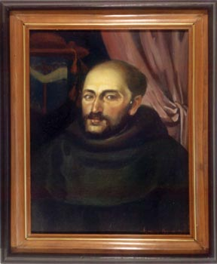
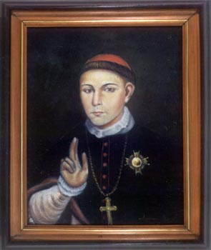
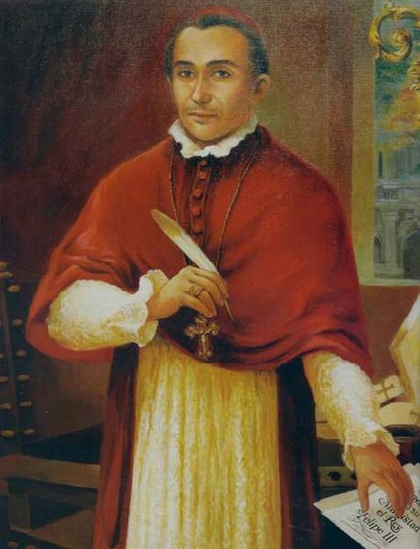
Miguel de Benavides
Archbishop of Manila,
1605
Focus on eradicating ‘unnatural acts’
Ignacio de Santibanez,
Archbishop of Manila, d.1598
Felip Pardo,
Rector UST,
d.1689

Slide 10
Francisco Ignacio Alcina (1668) History of the Bisayan Islands.
(Writing about ‘ancient times’….)
“The fact is the asog considered themselves more like women than like men in their manner of living, or going about, or even in their occupations. Some of them applied themselves to women’s tasks, like weaving and cultivating etc. In dress, although they did not wear petticoats (these were not worn by women in ancient times either) they did wear some lambon, as they are called here. This is a long skirt down to the feet, so that they were recognised even by their dress.”
Munoz text, translated by Leitz,PS., cited in Brewer,C. (1999).

Slide 11
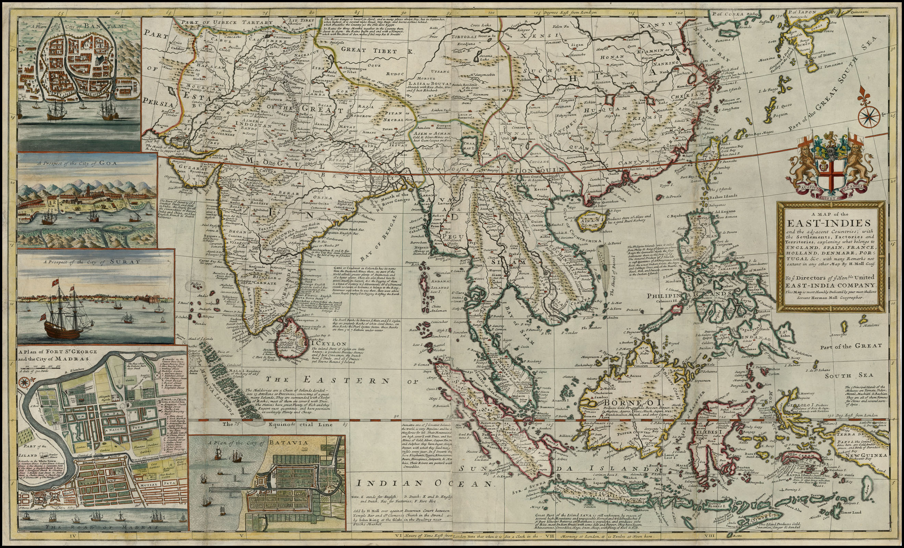
1565

Slide 12
1542
1557
1510
1511
1511
1514

Slide 13
1624
1619

Slide 17
“Trans” dancers, singers, musicians, actors,
spirit mediums, healers,
teachers etc.
Japan,
China, Korea,
Myanmar, Laos, Thailand,
Indonesia, Oman, Pakistan, Bangladesh,
Afghanistan
India
Philippines
Siberia
Pacific Islands
(Okinawa, Hawai'i, Samoa, Tonga, Tuva etc)
.

Slide 18
Gender pluralism (Peletz,M, 2006)
= “…pluralistic sensibilities and dispositions regarding bodily practices (adornment, attire, mannerisms) and embodied desires, as well as social roles, sexual relationships and ways of being that bear on or are otherwise linked with local conceptions of femininity, masculinity, androgyny etc.
….[pluralism] transcends and must be distinguished from dualism in that more than two principles, categories, groups etc are usually at stake and accorded legitimacy (not simply principles constituting categories of heteronormative female-bodied individuals and their male-bodied counterparts. ..(S)exual pluralism,,,is included under the more encompassing rubric of gender pluralism” (p310)
Categories recognisable to us as genders, based more on social and sexual behaviours than on biological maleness and femaleness, and whose members were valued members of their societies.
Peletz (2006) Transgenderism and gender pluralism in Southeast Asia since early modern times. Current Anthropology 47, 2, 309-340

Slide 19
Francisco Ignacio Alcina (1668) History of the Bisayan Islands.
(Writing about a native islander he knew…).
[This man] “is so effeminate in every way that he seemed
more like a woman than a man…. His dress was even over
the legs with a wide bahaque which resembled, under the
lambon, the old time petticoats. All the things that the
women did, he performed, such as weaving blankets,
and sewing clothes, making pots, which is the work
of [women]. He danced also like they did, never like a
man whose dance is different. In all he appeared more
a woman than a man.”
Munoz text, translated by Leitz,PS., cited in Brewer,C. (1999).

Slide 20
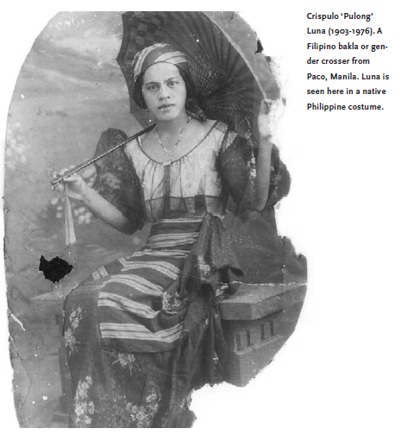
bakla (man-woman)
(=‘babae-lalake’, or ‘babae-akala’)
also binabae (like a woman)
bayot, bading etc..
denoting effeminate “gay” men and trans people.
“Despite Catholicism - with its own sacramental frocks worn by its ‘men of the cloth’ – and three hundred years of Spanish colonial rule, cross-dressing, effeminacy and gender transitive behaviour never really disappeared in Philippines society.”
Garcia, JN (2004)
Male homosexuality in the Philippines: a short history. IIAS newsletter, 35
Crispulo
‘Pulong’
Luna
(1903-1976)

Slide 22
w
w
Colonisation
Christianisation
New moralities
“Trans” as..
New ideas on health
“unnatural”
w
w
“contradicting God’s will”
Westernisation
Modernisation
Decline of gender pluralism
“sexually deviant”
Decline of “trans”
social roles
“deceptive”
w
w
“sick”
Globalisation
Industrialisation

Slide 24
Transpeople in the Asia-Pacific today
I estimate around 9 - 9.5 million trans* people in Asia-Pacific? (15 – 15.5 million worldwide?)
(@0.3% for 15+)
- see a paper by Winter and Conway on the TransgenderASIA website
A-P trans HIV prevalence rates to 49%. Other STIs high.
Commission on AIDS in Asia (2010) - By 2020 trans*and MSM will together constitute majority of new HIV infections
A health issue, a rights issue, a development issue

Slide 25
United Nations Development Programme ‘Transgender persons, human rights and HIV vulnerability in Asia and the Pacific.’

Slide 26
Transgender people:
Individuals whose gender identity and/or expression of their gender differs from social norms related to their gender of birth. The term… describes a wide range of identities, roles and experiences which can vary considerably from one culture to another’
Trans* people

Slide 27
‘Transgender persons, human rights and HIV vulnerability in Asia and the Pacific.’
Commissioned by UNDP May 2011
In response to calls from trans groups for more trans research
‘Desk review’
Review reviewed by trans group leaders and others
Publication due May 2012 (IDAHOT Day)

Slide 28
‘Transgender persons, human rights and HIV vulnerability in Asia and the Pacific.’
Aims:
To examine laws, regulations, policies and practices that prompt, reinforce, reflect or express stigma and prejudice towards trans* people
To identify vulnerabilities to HIV and barriers to access or uptake of HIV-related healthcare services, and:
To establish a research agenda aimed at providing the sort of data that will enable a reduction in future risk, as well as better access to treatment, care and support for transgender persons living with HIV.

Slide 29
‘Transgender persons, human rights and HIV vulnerability in Asia and the Pacific.’
A broad-brush picture of what the research shows

Slide 30
To the margins of society
Family and school
dropping out and leaving home

Slide 31
To the margins of society
Family and school
dropping out and leaving home
Wider society
employment, housing, health services, access to public spaces. Verbal abuse, violence (incl. sexual), murder.
86 known murders Jan08-Dec11
TGEU Trans* Murder Monitoring Project

Slide 32
To the margins of society
Family and school
dropping out and leaving home
Wider society
employment, housing, health services, , access to public spaces . Verbal abuse, violence (incl. sexual), murder.
drift towards ‘ghetto’ employment
World Bank estimates 35000 trans* female sex workers in Pakistan; around fifth of all sex workers.

Slide 33
To the margins of society
Family and school
dropping out and leaving home
Wider society
employment, housing, health services, access to public spaces. Verbal abuse, violence (incl. sexual), murder.
drift towards ‘ghetto’ employment
Government
documentation: ID cards,

Slide 34
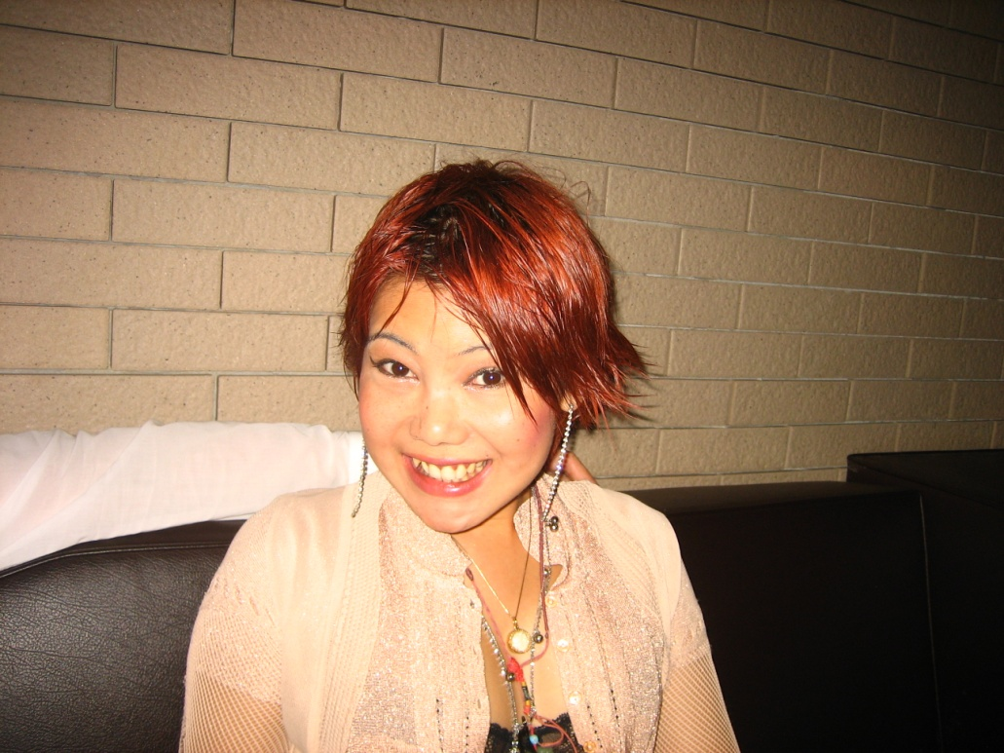
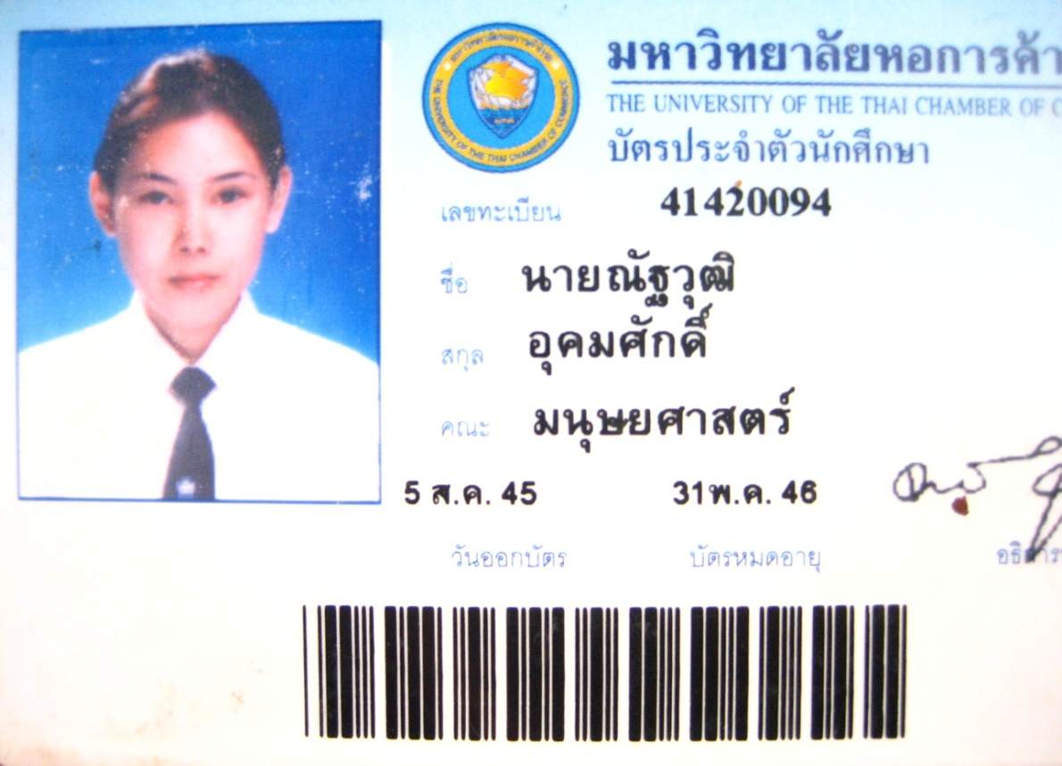
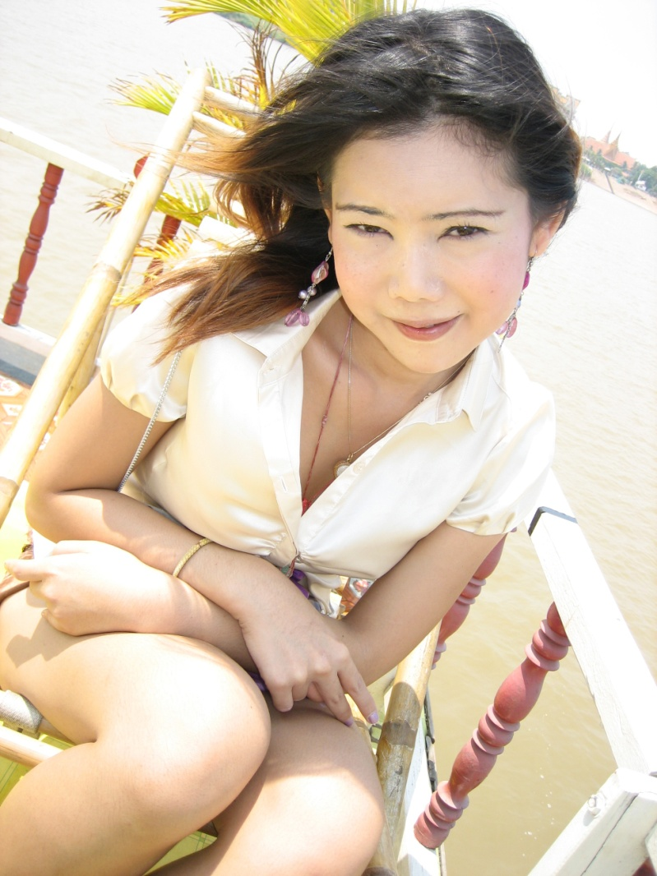
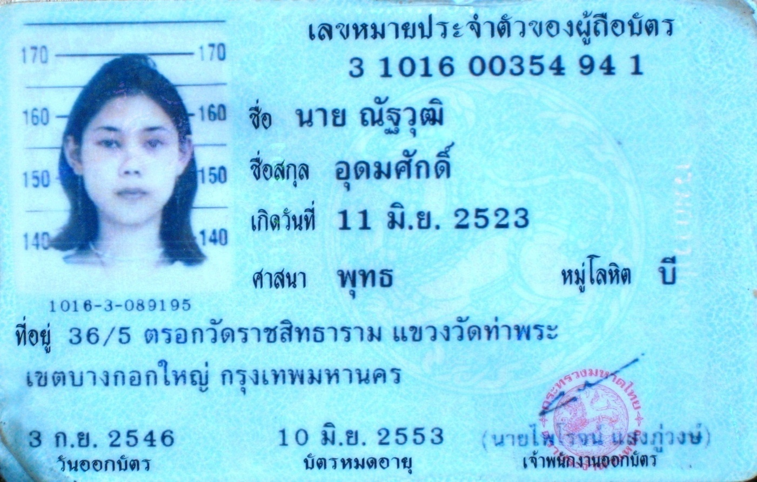

Slide 35
To the margins of society
Family and school
dropping out and leaving home
Wider society
employment, housing, health services, access to public spaces. Verbal abuse, violence (incl. sexual), murder.
drift towards ‘ghetto’ employment
Government
documentation: ID cards,
documentation: legal gender recognition
The right to heterosexual marriage. In Asia…
China, Taiwan, Singapore,
Japan, South Korea, Vietnam,
Iran, Kazakhstan, Turkey, Indonesia, Lebanon
Australia, New Zealand.

Slide 36
To the margins of society
Family and school
dropping out and leaving home
Wider society
employment, housing, health services, access to public spaces. Verbal abuse, violence (incl. sexual), murder.
drift towards ‘ghetto’ employment
Government
documentation: ID cards,
documentation: legal gender recognition
lack of protection against discrimination
despite the fact that many countries have signed international agreements to protect rights of all its citizens
e.g. ICCPR, ICESCR, CRC etc.

Slide 37
Trans-relevant rights in ICCPR, ICESCR, CRC ?
All following apply to all people without distinction of any kind, such as …. or any other status (ICCPR 2, ICESCR 2, CRC 2):
Freedom from: school discipline damaging to dignity (CRC 28), degrading treatment or punishment (ICCPR 7, CRC 37), arbitrary arrest or detention (ICCPR 9), interference with privacy (ICCPR 17, CRC 16) or attacks on reputation (CRC 17);
Rights to: education directed to full development of personality (ICESCR 13, CRC 29); expression (ICCPR 19, CRC 13), marriage (ICCPR 23), work (ICESCR 6) equal opportunity for promotion (ICESCR 7) adequate standard of living (ICESCR 11);
Protection against discrimination on any ground such as ,,,,, or any other status (ICCPR 26)
and CRPD? CEDAW?

Slide 38
To the margins of society
‘Imitating /impersonating the other sex’
e.g. Malaysia, Afghanistan, Samoa, Tonga, Kuwait …
Family and school
dropping out and leaving home
Wider society
employment, housing, health services, access to public spaces. Verbal abuse, violence (incl. sexual), murder.
drift towards ‘ghetto’ employment
Government
documentation: ID cards,
documentation: legal gender recognition
lack of protection against discrimination
criminalisation of gendered and sexual behaviour
Engaging in ‘same-sex’ behaviour.
e.g. Malaysia, Bangladesh, Pakistan, PNG, Samoa, Tonga etc
Doing sex work where it
is criminalised
e.g. Pakistan, Laos, Cambodia, China, Thailand etc.
or is regulated.
e.g. India, Malaysia, Singapore, Hong Kong etc

Slide 39
To the margins of society
Family and school
dropping out and leaving home
Wider society
employment, housing, health services, access to public spaces. Verbal abuse, violence (incl. sexual), murder.
drift towards ‘ghetto’ employment
Government
documentation: ID cards,
documentation: legal gender recognition
lack of protection against discrimination
criminalisation of gendered and sexual behaviour
police harassment, violence
e.g. Bangladesh, Nepal, Kuwait, India, Uzbekistan, Kyrgyzstan, Sri Lanka, Thailand, Cambodia, Iraq, Turkey etc.

Slide 41






The Stigma-Sickness Slope
Stigma
Harassment + Abuse
Prejudice + Discrimination
Violence
Marginalisation
(social, economic, legal)
Poverty
Poor physical / emotional well-being
Risky
situations + behaviours
Sex work
Sickness
HIV/AIDS
Inadequate health care
Death

Slide 43
Trans* action in Asia

Slide 44
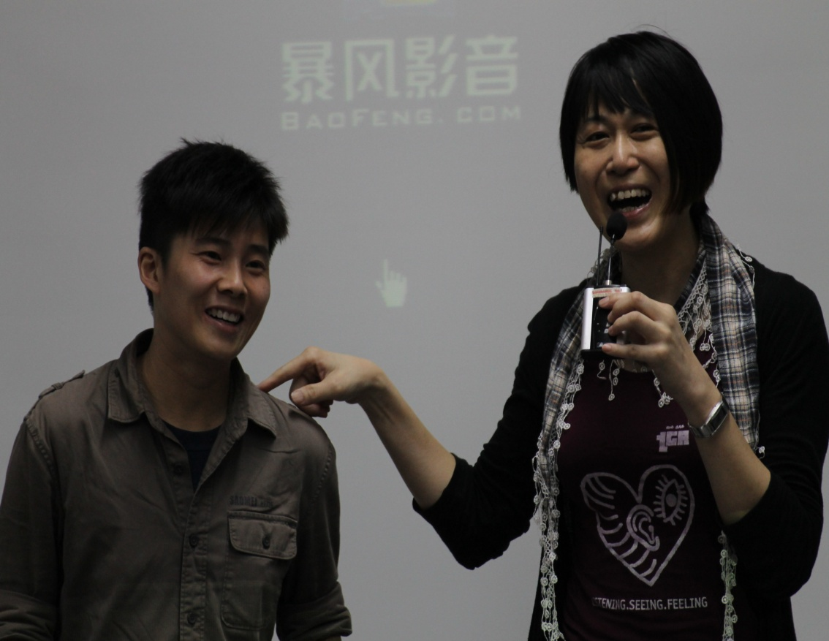
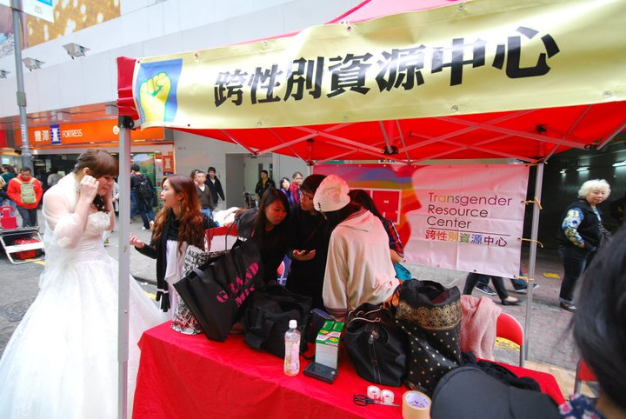
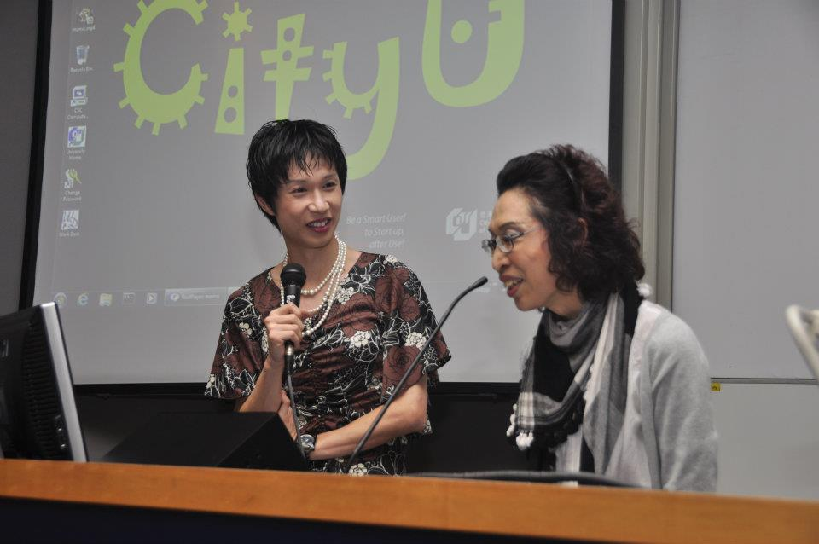
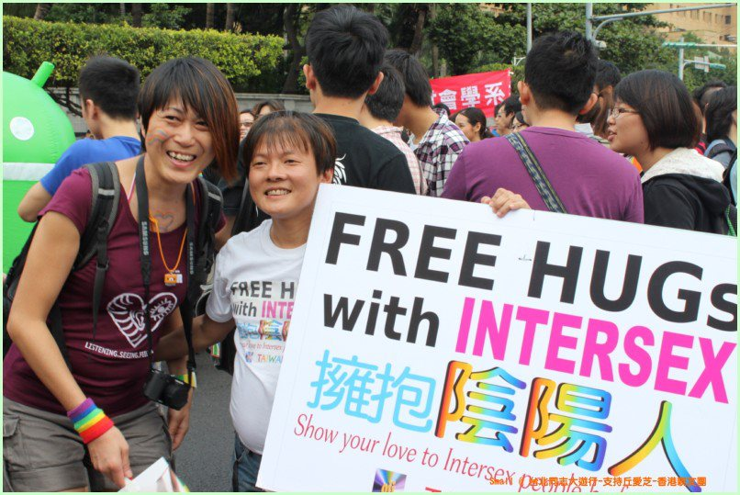

Slide 45
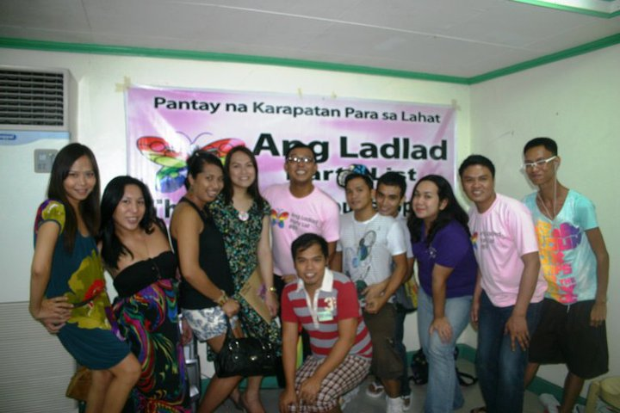
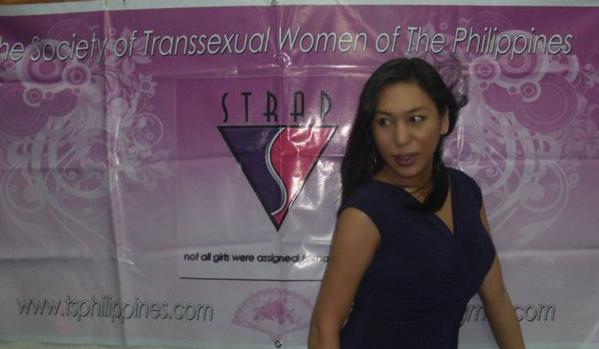
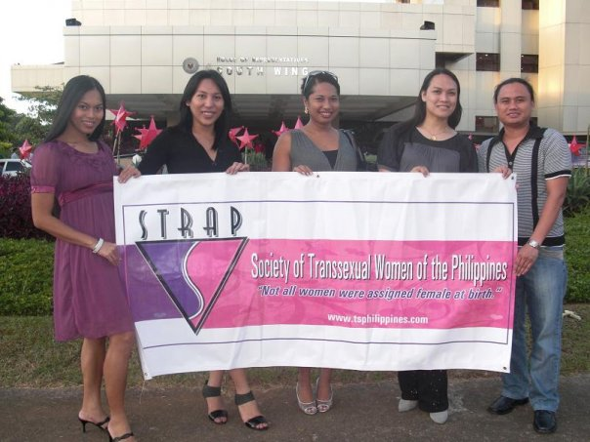
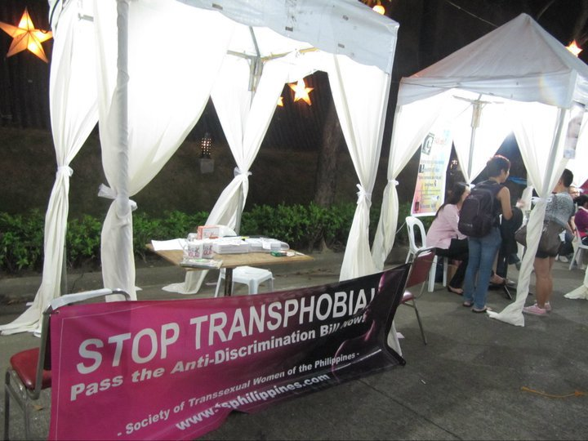

Slide 46
Trans* action in action
Coming out, speaking up
eg SGDS
Organising locally, coming out from under the GLB umbrella
- eg STRAP(M/C), COLORS; TEAM, GC, TGR; TTA, TAT
Establishing identities separate from GLB
eg Kwan sing bit yan si; khon khaam phet; mak-pak-nyah; transpinay/transpinoy Pat Bringas, Miss Malaysia
Working on on local and national health and rights issues
eg STRAP: discrimination; anti-discrimination legislation
eg TGR: gender recognition (marriage rights; ID); training for health professionals; information booklet
Reaching out further
eg STRAP (SGDS); TGR (in China)
Linking up regionally and internationally
eg APTN; APCOM, GATE; UNDP, UNAIDS, WHO; CONGENID, ICAAP; UN
Speaking out on international issues
HIV/AIDS, sex worker rights, health information, health rights, research needs
Diagnostic reform (APTN, STRAP)
Bringing in the trans*men
STRAP, TGR, APTN

Slide 47
‘Transgender persons, human rights and HIV vulnerability in Asia and the Pacific’ : Recommendations for research that:
ends the invisibility of trans*people
avoids cisgenderism
involves trans* people as research partners
counts trans*people (to make them count)
documents and understands trans* vulnerabilities
moves from risk to resilience
helps empower trans* people (through their CBOs and NGOs) to
promote trans* positive attitudes and practices
promote a trans* rights culture, making equality legislation work
get health information out to trans* communities
promote trans* positive, competent, comprehensive, accessible healthcare.

Slide 48
Thank you : sjwinter@hku.hk Websites http://web.hku.hk/~sjwinter/TransgenderASIA http://web.hku.hk/~sjwinter/General

Slide 49
“When did you first discover you were gay..?” (@3:40) Getting the message out on ’Headstart’ (April 2012) Pat Bringas, President UP Babaylan (LGBT organisation), Member UP Student Council Section One (16m) (from 2:20, definitions; transition; 9;00 genital surgery; what makes me a woman – identity 9:54 ; documentation 12:40) and Two (14m) getting to grips with bisexual v transsexual 0:00; fighting for pageant entry or anti-discrimination legislation 3:04; why pageants? 4:38; religious issues 5:00; commenting on Vince Santiago 5:50; do all members of UP babaylan look like women? 6:40; a TG pageant winner a slap in women’s faces 7:05; dormitories 8:10; TG should know their limits 8:55; fielding other questions; closing comments 12:05

Slide 50
Transpinay rising (5:30)

